Slide 1

Pain and chronic illness
Dr David Biggs
PSY1001 Psychology in practice
Notes:
Original slides by Dr Melinda Spencer, updated by David Biggs 05/01/2024

Slide 2

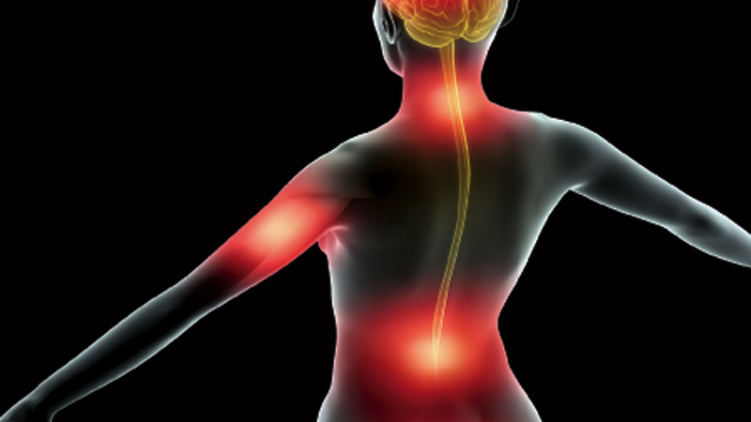
What is pain?
A biological safety mechanism – survival functions
Subjective – hard to describe
Not visible
Multidimensional phenomenon – biology, psychology, behaviour

Slide 3
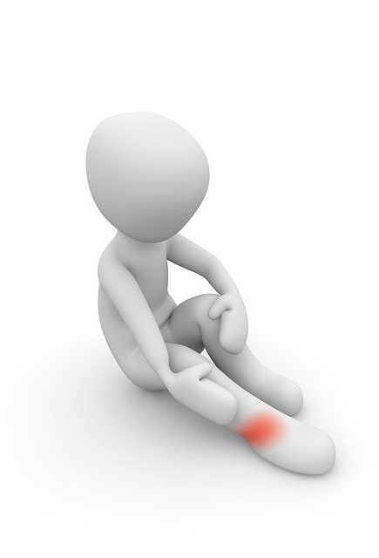
What is pain?
Pain without obvious injury
Neuralgia
Causalgia
Phantom limb syndrome

Slide 4
Beecher (1956)
Zborowski (1958)
Two different groups – medication for similar injuries
WWII – soldiers severely wounded. 49% claimed to be in severe or moderate pain, 32% accepted medication when offered
Civilians with less severe but similar injuries. 75% reported feeling severe to moderate pain, 83% accepted medication when offered
Pain threshold in 4 different cultural groups living in the US
Old Americans, Jews, Irish & Italians
Jews & Italians – lower pain threshold, reacting more emotionally
Old Americans – accepting, Irish - stoical

Slide 5
Racial bias in medicine
Race-based physiological myths have long influenced medical practice
Some doctors believe that African-Americans are more tolerant of pain.
One study found that relative to other racial groups, physicians are twice as likely to underestimate black patients’ pain.
Notes:
See https://globalhealth.harvard.edu/racial-bias-in-medicine/#:~:text=Race%2Dbased%20physiological%20myths%20have,to%20underestimate%20black%20patients'%20pain.
And https://pubmed.ncbi.nlm.nih.gov/17534011/

Slide 6
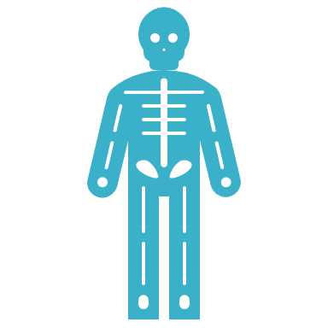
Explaining Pain
Early theories – Pattern theory & Specificity theory – pain is purely physiological
Do not explain placebo effects, hypnosis & distraction
Gate Control Theory (Melzack & Wall, 1965, 1982). Pain requires:
1. Stimulation of the pain receptors.
2. Activation of a ‘neural gate’
3. Central control mechanism

Slide 7

4 types of pain behaviours (Turk, Wack & Kerns, 1985)
Facial or audible expressions of distress
Distorted movement or posture
Negative emotions or feelings
Avoiding activity

Slide 8

Psychological treatments of pain
Biofeedback
Relaxation techniques
Cognitive techniques
Imagery
Pain redefinition
Mindfulness meditation

Slide 9
Chronic Illness
“Chronic diseases are diseases of long duration and generally slow progression. Chronic diseases, such as heart disease, stroke, cancer, chronic respiratory diseases and diabetes, are by far the leading cause of mortality in the world, representing 63% of all deaths” (WHO)
No medical ‘cure’ currently available
‘Lingers’ with no time limit on its duration (Gabe, Bury, & Ramsay, 2002)

Slide 10

Noncommunicable diseases
Diseases of long duration and generally slow progression
Leading cause of death in the world (representing 63% of all annual deaths
NCDs kill more than 36million people each year
80% of all NCD deaths occur in low- middle- income countries
Four main types:
Cardiovascular diseases (heart attacks and stroke)
Cancer
Chronic respiratory diseases (COPD and asthma)

Slide 11
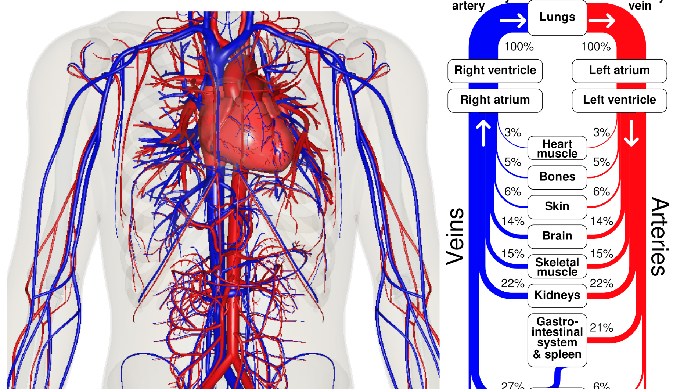
Disorders of the cardiovascular system
Coronary artery disease (CAD)
Myocardial Infaction (MI)
Angina Pectoris
Stroke
Hypertension
This Photo by Unknown Author is licensed under CC BY-SA-NC

Slide 12

Risk factors for CHD
Inherent
Physiological
Behavioural
Psychosocial
Dispositional

Slide 13

Research designs for CHD
Prospective studies
Cross sectional studies

Slide 14
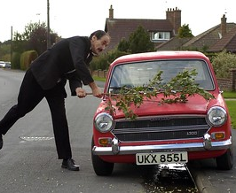
CHD and Type A behaviour
Rosenman and Friedman
Type A Behaviour Pattern (TABP) – action-emotional complex
Behavioural dispositions
Specific behaviours
Emotional responses
“an action emotion complex in response to their chronic and excessive struggle to achieve more and more from their environment in too short a period of time and against opposing efforts of other persons or things in the same environment” (Rosenman, 1978)
This Photo by Unknown Author is licensed under CC BY-ND

Slide 15

Measuring Type A behaviour
Structured interviews
The Jenkins Activity Survey (Jenkins et al. 1978)
The Framingham Type A Scale (Haynes et al. 1979)
The Bortner Rating Scale (Price, 1979)

Slide 16
How could Type A Behaviour and Hostility contribute to heart disease?
May react more strongly at the physiological level to stress – more likely to evidence physiological damage
TAB and hostility – a consequence of exaggerated neuroendocrine responses to external stressors. Behaviour may be a way of coping with heightened level of arousal
TAB and hostility – may create a more stressful environment for themselves – more stress and challenges

Slide 17
Conclusion
Pain is relative
Unlikely that different groups experience pain differently
Chronic disease is something many have to live with (hypertension for instance)
Health psychologists use their skills and knowledge of psychology to promote wellbeing and healthy behaviours across the population to mitigate pain or chronic disease.

Slide 18

References
Ogden (2019) Health Psychology: A textbook Open University Press
Sarafino E.P (2011) Health Psychology: Biopsychosocial Interactions Wiley
Staton, L.J et al (2007) When race matters: disagreement in pain perception between patients and their physicians in primary care J Natl Med Assoc 99(5):532-8. see https://pubmed.ncbi.nlm.nih.gov/17534011/

